Slide 1
Understanding Conformance Testing Using the NIST HL7 v2 LRI-EHR Validation Tool
Conformance Criterion:
Incorporate laboratory tests and values/results
Robert Snelick, NIST (rsnelick@nist.gov)
V1.2 November 16, 2016

Slide 2
Purpose
Provide an additional resource to explain the process of HIT Module conformance testing related to HL7 v2 Laboratory Results Interface-Electronic Health Record (LRI-EHR) Messaging
Describe NIST approach for assessing and validating the test messages
Provide an overview of the testing requirements

Slide 3
Table of Contents
List of Resources
Scope of Conformance Testing
Incorporate laboratory tests and values/results criterion and conformance standards
Testing Process Diagram
Testing Workflow Diagrams
Explanation of Test Scenarios and Test Cases/Steps
Example Test Step Documents
Test Tool Overview and Example Test Tool Screen
Additional Resources

Slide 4
Resources
Test Tool Web Site (http://hl7v2-lab-r2-testing.nist.gov/lri-r2/#/home )
Validation Tools
User Documentation
Normative Test Process Document (on Test Tool Documentation Tab)
S&I Framework Lab Results Interface (LRI) Implementation Guide
(http://www.hl7.org/implement/standards/product_brief.cfm?product_id=279)
S&I Framework EHR-S Functional Requirements for Laboratory Results Messages
(http://www.hl7.org/implement/standards/product_brief.cfm?product_id=433 )
LRI-EHR Tool Quick Reference Guide (In Process)
LRI-EHR Tool Tutorial (In Process)
Release Notes for each version of Test Tool
(on Test Tool Documentation Tab)
LRI Test Tool Google Group for submitting questions to the Test Tool developers Same url is used for ONC 2014 Edition LRI Test Tool (https://groups.google.com/d/forum/hl7v2-lab-testing)

Slide 5
Scope of Conformance Testing - LRI-EHR
Testing is directed at a Health IT Module (product), not specific instances (installations) of the Module
The conformance criterion is focused on testing the capability of an HIT Module to receive, incorporate, and display clinical laboratory test results from HL7 messages created for electronic transmission
Site-specific configuration of the HIT Module is not being tested
Method of transmitting the result messages is not being tested
Testing focus and scope are narrow
Testing encompasses only specific use cases described in the LRI Implementation Guide (IG)
Testing does not attempt to address the entire spectrum of use cases found in practice
How the LRI messages are received/imported into the HIT Module is out of scope
Sending LIS systems are not being tested using the EHR Test Plan in the LRI Test Tool (sending LIS systems are being tested using the LIS Test Plan in the LRI Test Tool)
HIT Module conformance testing is driven by the test data
The HIT Module is required to demonstrate the ability to receive HL7 v2 lab result messages and to display and incorporate the lab results; specific test data for the messages are provided in Test Cases
The test data and Test Cases do not cover all possible clinical lab tests; through consultation with clinical laboratory experts, a subset of key lab tests were selected for testing
The format in which the test data are displayed on the screen of the HIT Module is not part of the testing
Clinical laboratory subject matter experts, in collaboration with the National Institute of Standards and Technology (NIST), provided the Test Scenarios, Test Cases, and Test Data for the Laboratory Results Interface (LRI) conformance testing

Slide 6
Conformance Criterion - LRI-EHR
Incorporate laboratory tests and values/results testing evaluates the capability for an HIT Module to
Receive, incorporate, and display laboratory test values/results using
HL7 Version 2.5.1 Implementation Guide: S&I Framework Lab Results Interface, Release 1, DSTU Release 2 – US Realm, September 2015 (Referred to as LRI IG)
HL7 EHR-S Functional Requirements: S&I Framework Laboratory Results Messages, Release 1 - US Realm, STU May 2016
LOINC® version 2.50
Display the lab test values/results in human readable format
Display test report information including
Patient identification information (e.g., name, ID number)
Name of test performed
Report date
Calculated results
Reference ranges
Interpretations (e.g., high, low)
Associate/link a lab result with a lab order or patient record

Slide 7
Conformance Standards - LRI-EHR
Electronic incorporation and transmission of lab results
HL7 Version 2.5.1 Implementation Guide: S&I Framework Lab Results Interface, Release 1, DSTU Release 2 – US Realm, September 2015
HL7 EHR-S Functional Requirements: S&I Framework Laboratory Results Messages, Release 1 - US Realm, STU May 2016
Vocabulary for representing electronic health information
Logical Observation Identifiers Names and Codes (LOINC®) Database version 2.50, a universal code system for identifying laboratory and clinical observations produced by the Regenstrief Institute, Inc.
Regulatory requirements
For test report information as specified in 42 CFR 493.1291(a)(1) and (c)(1) through (7)
Related to reference intervals or normal values as specified in 42 CFR 493.1291(d)
For corrected reports as specified in 42 CFR 493.1291(k)(2)

Slide 8
Conformance Standards - LRI-EHR (cont’d)
Regulatory requirements details
For test report information as specified in 42 CFR 493.1291(a)(1)
Results reported from calculated data
For test report information as specified in 42 CFR 493.1291(c)(1) - (7)
The test report must indicate the following:
(1) For positive patient identification, either the patient's name and identification number, or a unique patient identifier and identification number.
(2) The name and address of the laboratory location where the test was performed.
(3) The test report date.
(4) The test performed.
(5) Specimen source, when appropriate.
(6) The test result and, if applicable, the units of measurement or interpretation, or both.
(7) Any information regarding the condition and disposition of specimens that do not meet the laboratory's criteria for acceptability.
(See LRI guide section 8.2 for more details)

Slide 9
Conformance Standards - LRI-EHR (cont’d)
Regulatory requirements details (cont’d)
Related to reference intervals or normal values as specified in 42 CFR 493.1291(d)
Pertinent “reference intervals” or “normal” values, as determined by the laboratory performing the tests, must be available to the authorized person who ordered the tests and, if applicable, the individual responsible for using the test results.
For corrected reports as specified in 42 CFR 493.1291(k)(2)
When errors in the reported patient test results are detected, the laboratory must issue corrected reports [promptly] to the authorized person ordering the test and, if applicable, the individual using the test results

Slide 10
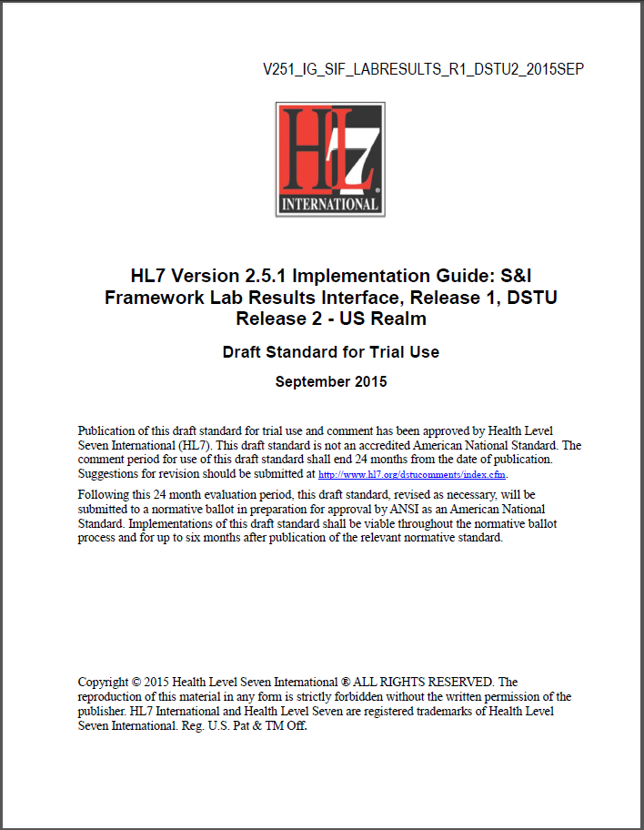
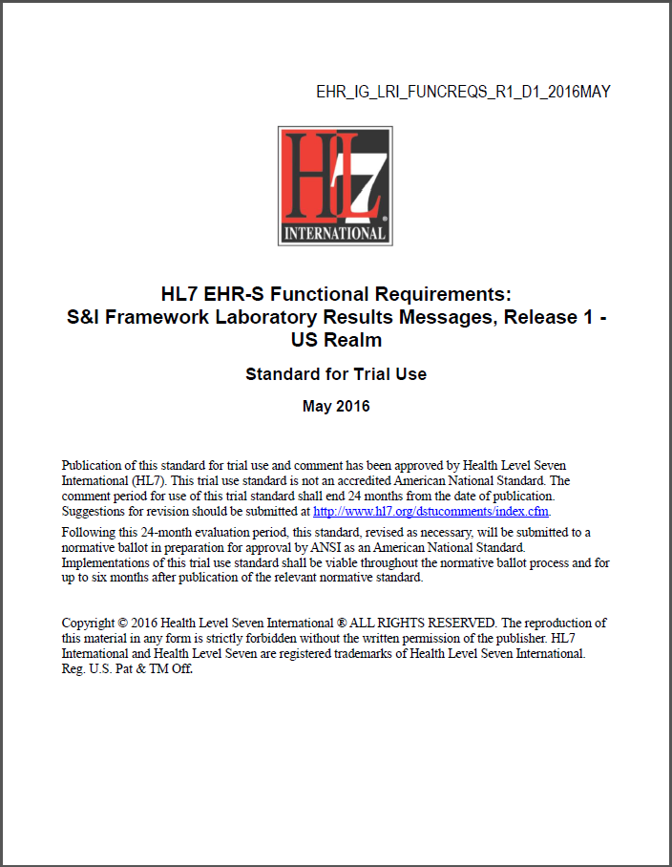
Conformance Standards Documents – LRI-EHR
HL7 v2.5.1 LRI Implementation Guide, Release 1, DSTU Release 2, Sept 2015
HL7 EHR-S Functional Requirements: Lab Results Messages, Release 1, STU May 2016
http://www.hl7.org/implement/standards/product_brief.cfm?product_id=279
http://www.hl7.org/implement/standards/product_brief.cfm?product_id=433

Slide 11

Vocabulary Standard Web Site – LRI-EHR
LOINC® Database version 2.50
http://loinc.org/

Slide 12
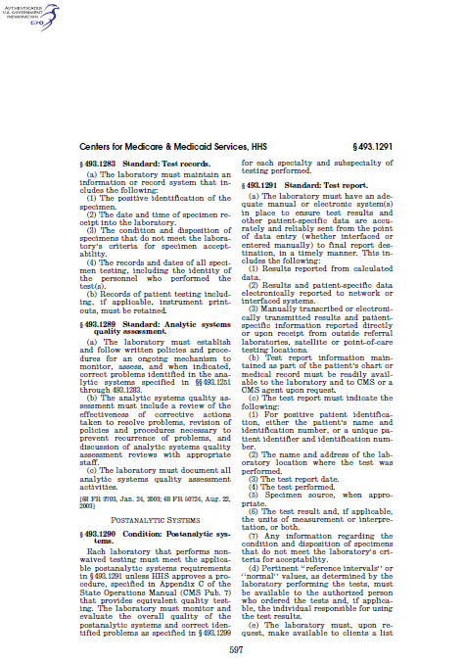
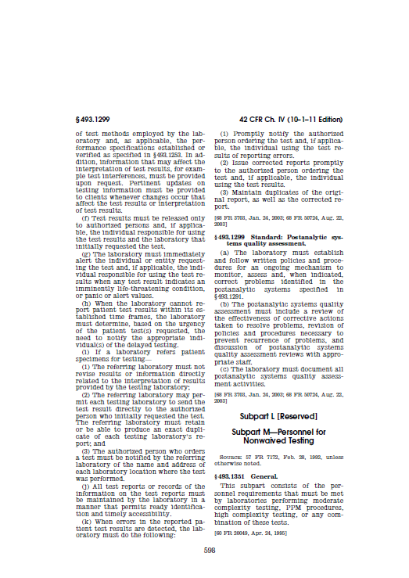
Regulatory Standards Documents – LRI-EHR
42 CFR 493.1291 (a)(1)
42 CFR 493.1291 (c)(1-7)
42 CFR 493.1291 (K)(2)
http://www.google.com/url?sa=t&rct=j&q=&esrc=s&frm=1&source=web&cd=1&cad=rja&ved=0CC0QFjAA&url=http%3A%2F%2Fwww.gpo.gov%2Ffdsys%2Fpkg%2FCFR-2011-title42-vol5%2Fpdf%2FCFR-2011-title42-vol5-sec493-1291.pdf&ei=-zqNUZ_GHPPh0AH0yoCwCw&usg=AFQjCNG6cld1LSwjSm88kzZ2Nc7pBvAyOg&sig2=26-ppMeldUd9GW86VUbZSg

Slide 13
Receive and Incorporate Lab Results Testing Process
HL7 LRI IG 2015
NIST Validation Tool
HIT Module
(System under Test)
Conformance Test Scope
ORU Message
Configuration of Changeable Data as Needed
ORU Elements
Visual Inspection
Message
Exported/Imported*
ORU Message Elements
Juror Document
Diagram does not show testing process for Acknowledgment messages
HL7 EHR-S Functional Requirements LRI 2016
The HIT Module is the system being tested. The Module is required to receive* and process HL7 messages that meet the conformance, vocabulary, and regulatory standards (see previous slides), and to incorporate and display specific test data contained in the messages.
The messages are exported* from the NIST Test Tool and imported* into the Module, and validation (visual inspection) is performed by the Tester/Inspector using the Test Step-specific Juror Document.
Test data are available through the Test Tool via the Test Steps in the Test Cases. Each Test Step includes a Test Story that provides the context, a Test Data Specification that lists the data that are typically available in the clinical setting, a Message Content Data Sheet that shows a conformant message (in a table format) including a detailed profile of the required elements, a Test Message, and a Juror Document.
*How the message is exported/imported/received is not in-scope for certification testing

Slide 14
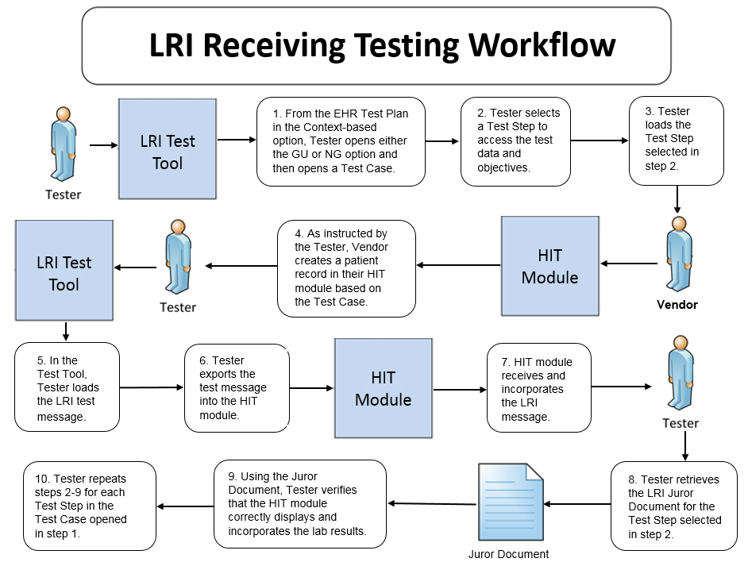
Receive and Incorporate Testing Workflow Diagram
This diagram shows
How the steps of the receive and incorporate test are sequenced
When the Test Tool is to be used

Slide 15
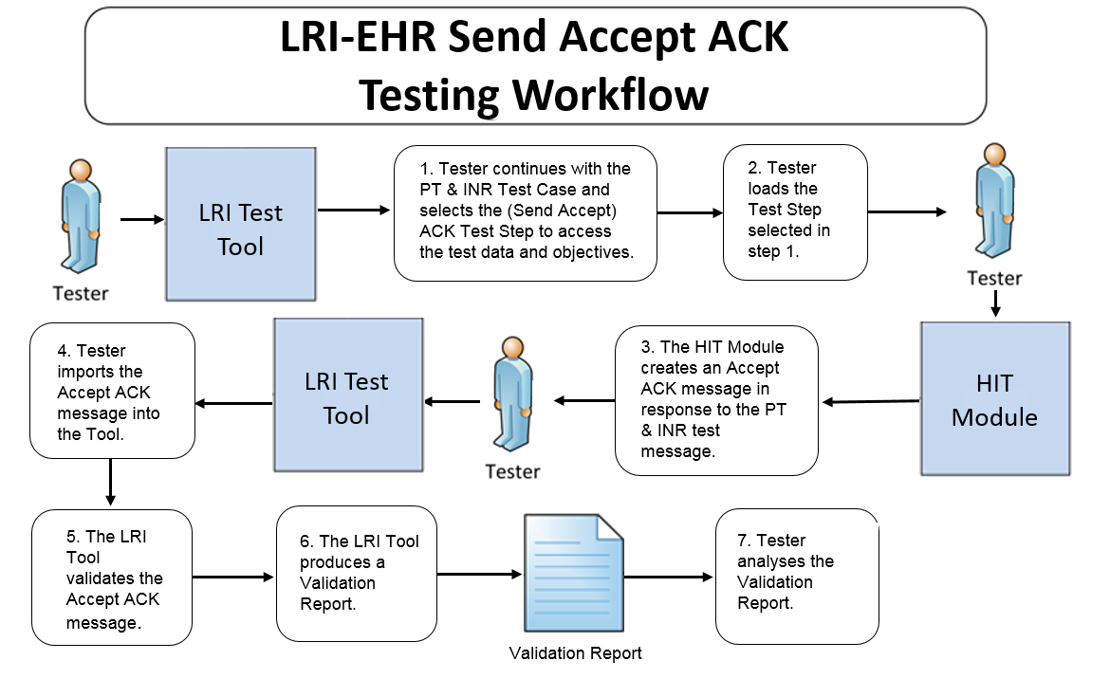
Send Accept ACK Testing Workflow Diagram
This diagram shows
How the steps of the send Accept Acknowledgement* test are sequenced
When the Test Tool is to be used
*Acknowledgement messages are tested only in the PT & INR Test Scenario

Slide 16
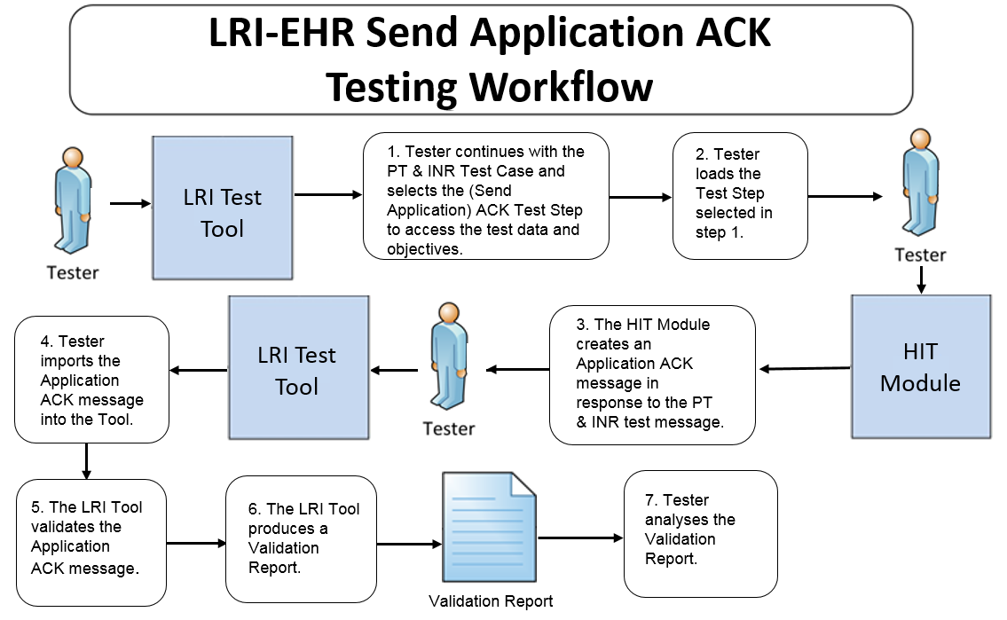
Send Application ACK Testing Workflow Diagram
This diagram shows
How the steps of the send Application Acknowledgement* test are sequenced
When the Test Tool is to be used
*Acknowledgement messages are tested only in the PT & INR Test Scenario

Slide 17
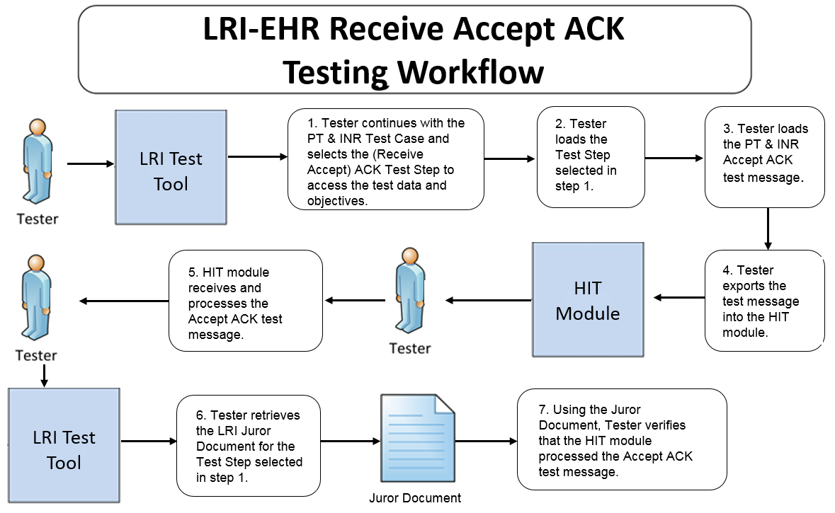
Receive Accept ACK Testing Workflow Diagram
This diagram shows
How the test steps are sequenced for the receive Accept Acknowledgement* message (sent in response to the Application Acknowledgement message)
When the Test Tool is to be used
*Acknowledgement messages are tested only in the PT & INR Test Scenario

Slide 18
Test Scenarios and Test Cases/Steps
Test data are available in the LRI Test Tool via the Test Scenarios provided in the EHR Test Plan
The Test Scenarios are composed of Test Cases and/or Test Steps
Each Test Step includes a Test Story, Test Data Specification, Message Content Data Sheet, Test Message, and (where applicable) a Juror Document
The HL7 Version 2.5.1 Implementation Guide: S&I Framework Lab Results Interface (LRI) interoperability standard defines four Profile options relevant for conformance testing:
LRI_NG_FRU_Profile – ID: 2.16.840.1.113883.9.195.3.3
LRI_NG_FRN_Profile – ID: 2.16.840.1.113883.9.195.3.4
LRI_GU_FRU_Profile – ID: 2.16.840.1.113883.9.195.3.1
LRI_GU_FRN_Profile – ID: 2.16.840.1.113883.9.195.3.2
The Tool provides seven Test Scenarios for the NG Profile options and seven for the GU Profile options
For the purpose of the testing, conformance to only one Profile option is required — the Vendor will inform the Tester as to which Profile option their HIT Module is conformant

Slide 19
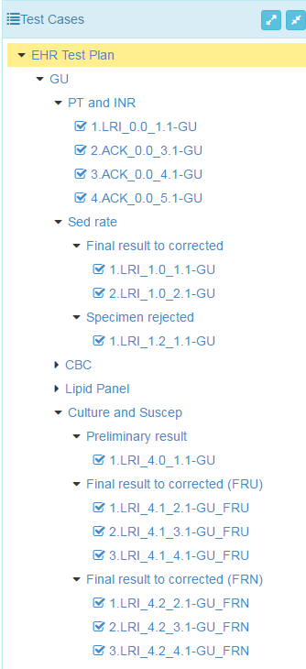
Test Scenarios and Test Cases/Steps (cont’d)
Test Scenarios/Cases/Steps for the four Profile options are provided in the EHR Test Plan in the LRI Test Tool
This figure shows a sub-set of the Test Scenarios/Cases/Steps in the EHR Test Plan for the GU Profile option
The Tester shall execute all seven Test Scenarios for either the GU or NG Profile
For certain Test Scenarios, the Tester need not execute optional* Test Cases
Profile option
Test Scenario
Test Step
Test Scenario
Test Case
Test Step
*Support for the capabilities in optional Test Cases is preferred but not required

Slide 20
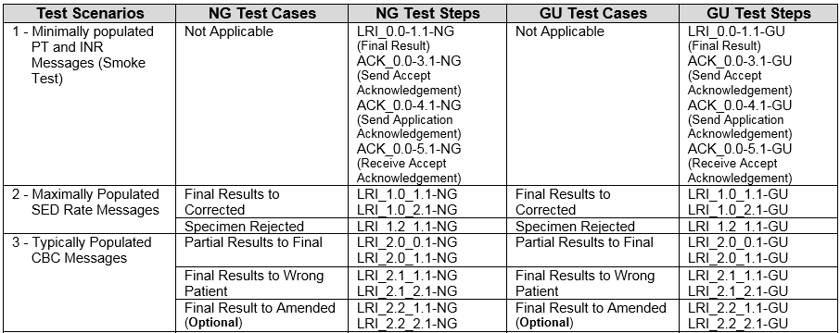
Test Scenarios and Test Cases/Steps (cont’d)
Test Cases/Steps for Scenarios 1 – 3 are shown in the table below
Minimally populated means the LRI example messages contain single occurrences of all required ("R") elements
Maximally populated means the LRI example messages contain all the R, RE, C(a/b) elements defined in the implementation guide
Typically populated means the LRI example message contains data that are routinely sent whether the data element is R (Required) or RE (Required, but may be empty)

Slide 21
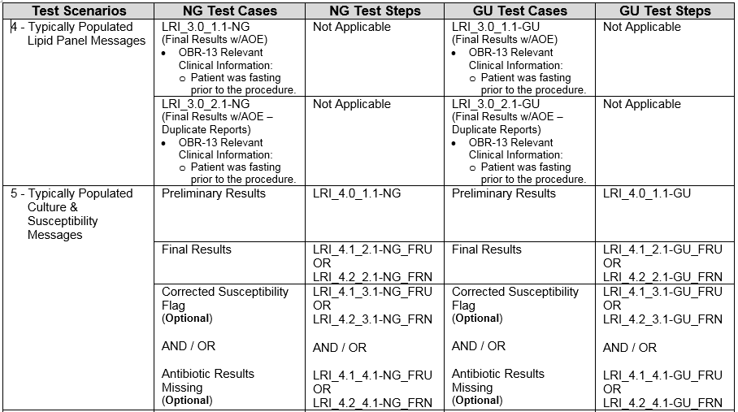
Test Scenarios and Test Cases/Steps (cont’d)
Test Cases/Steps for Scenarios 4 – 5 are shown in the table below

Slide 22
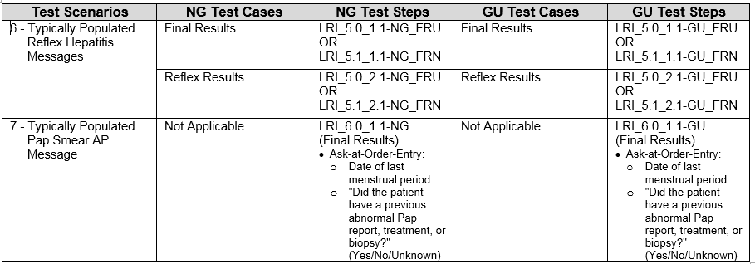
Test Scenarios and Test Cases/Steps (cont’d)
Test Cases/Steps for Scenarios 6 – 7 are shown in the table below

Slide 23
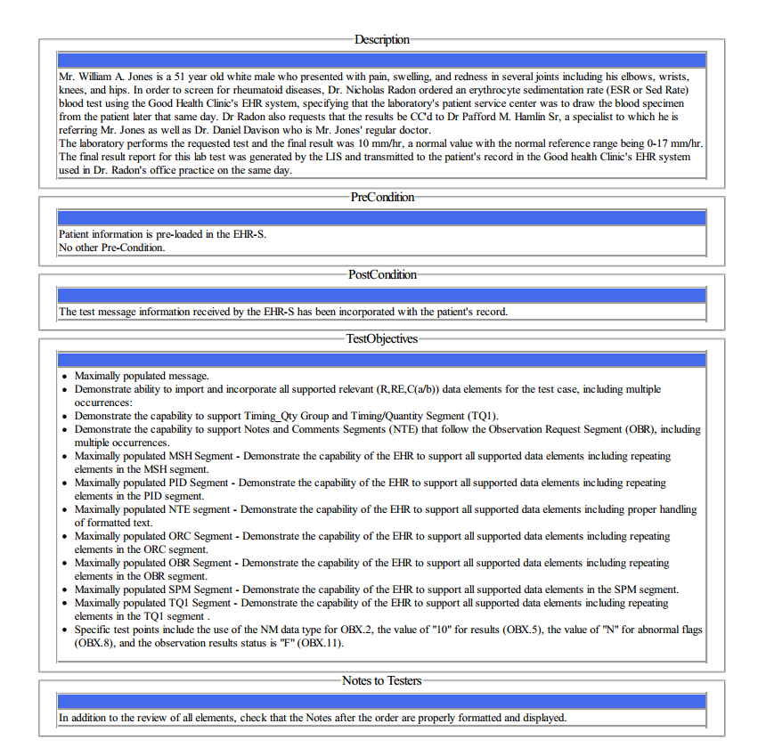
Test Data Documents* for Each Test Step
Test Story
Each Test Step includes a narrative Test Story that describes a real world situation and provides context for the Test Step
Along with the Test Story description is information about PreConditions, PostConditions, Test Objectives, and Notes to Testers
Example: Test Data pdf document for the LRI_1.0_1.1-GU_ Sed Rate Final Result Test Step
*Available for viewing online and via downloaded pdf or txt file

Slide 24
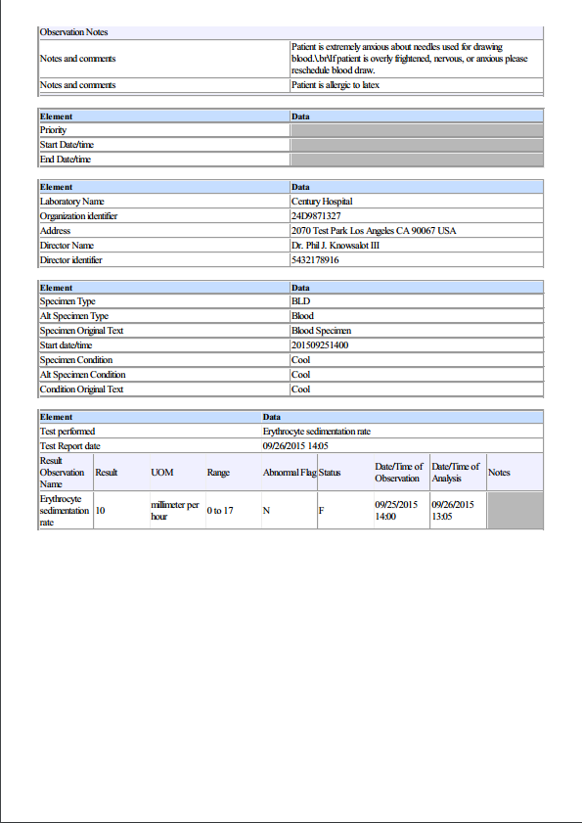
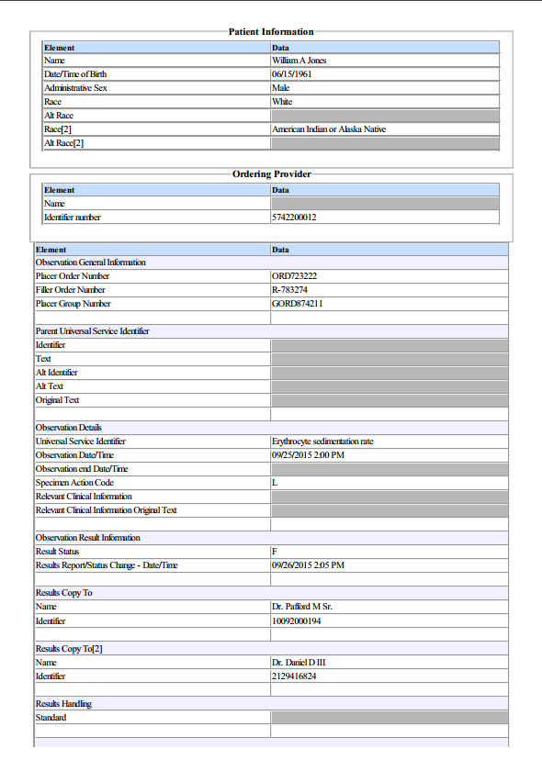
Test Data Documents for Each Test Step (cont’d)
Test Data Specification
Each Test Step includes a Test Data Specification that
Lists data associated with the Test Story
Consists of typical information found in the clinical setting
A test message is generated using these data and the LRI-EHR Test Tool functions
Example: Test Data pdf document for the LRI_1.0_1.1-GU_ Sed Rate Final Result Test Step
24
Notes:
24

Slide 25
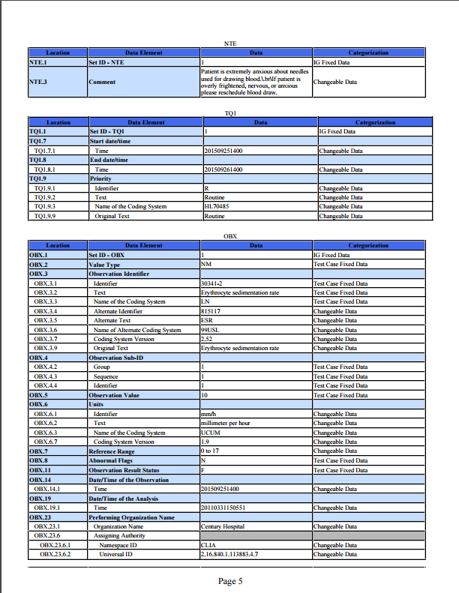
Test Data Documents for Each Test Step (cont’d)
Message Content Data Sheet
Each Test Step includes a Message Content Data Sheet that shows a conformant message instance
The category of the test data is listed in the Categorization column
The Categorization indicates how the data in the messages that are imported into the Tool are assessed by the validation engine
Example: Test Data pdf document for the LRI_1.0_1.1-GU_ Sed Rate Final Result Test Step
25
Notes:
25

Slide 26
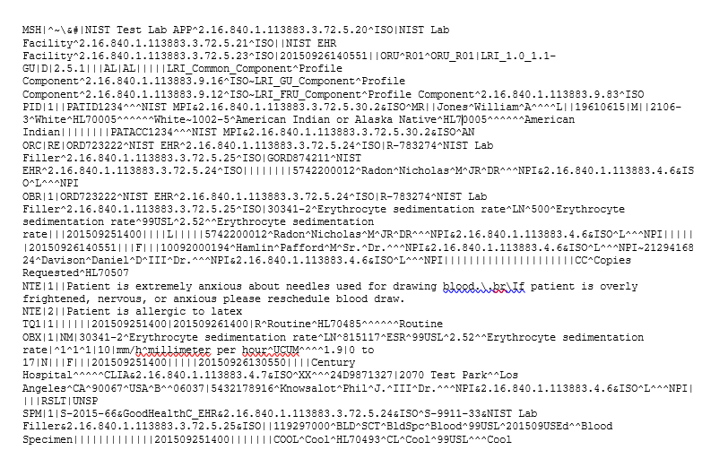

Test Data Documents for Each Test Step (cont’d)
Example Test Message
A test message is provided that coincides with the Test Story for the Test Step
For the EHR Test Plan
The lab result test messages are exported (sent) by the LRI Test Tool (acting as the LIS or EHR-S lab module) and are imported (received) by the HIT Module being tested
Two ACK messages are sent by the HIT Module and received by the LRI Test Tool, and one ACK message is sent by the LRI Test Tool and received by the HIT Module
Example: Test Message for the LRI_1.0_1.1-GU_Final Sed Rate Test Step
Example: Test Message for the ACK_0.0_3.1-GU PT & INR Test Step

Slide 27
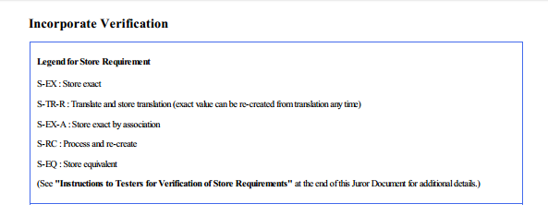
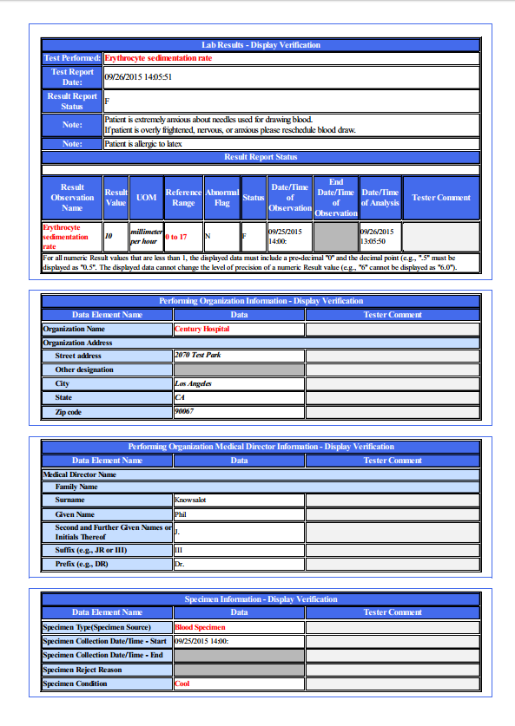
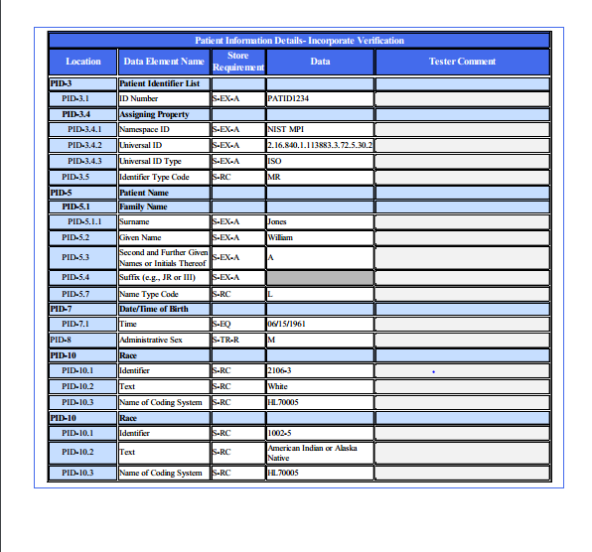
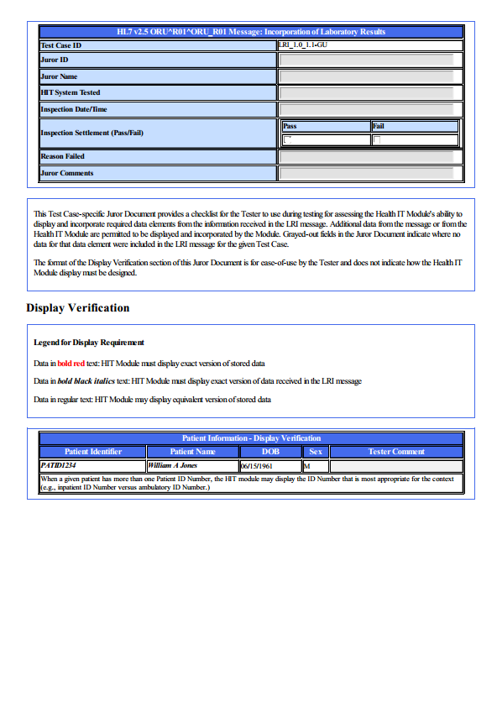
Test Data Documents for Each Test Step (cont’d)
Juror Document
Each (receiver) Test Step includes a Juror Document – a checklist used by the Tester/Inspector to assess and record whether the result data in the Test Message are displayed and incorporated into the HIT Module according to the LRI Functional Requirements specification
Example: Test Data pdf document for the LRI_1.0-GU_Final Sed Rate Test Step
27
Notes:
27

Slide 28
The Juror Document
Some elements contained in the messages are not subject to display or incorporate verification and are not listed on the Juror Document
Juror Document categorizes test data according to how the data in the HIT Module are to be verified
Document is composed of two sets of tables
“Display Verification”
Lists the data that are required to be displayed in the Module in accordance with the EHR-S Functional Requirements for LRI*
Used by the Tester to verify and document that the data are viewable in the Module by the user in the specified manner
Allows the Tester to compare the data on the Module’s screen to the Functional Requirements for data display
“Incorporate Verification”
Lists the data that are required to be incorporated into the Module in accordance with the EHR-S Functional Requirements for LRI
Used by the Tester to verify and document that the data are incorporated into the Module in the specified manner
*Acknowledgement (ACK) messages were not specified in this Functional Requirements document

Slide 29
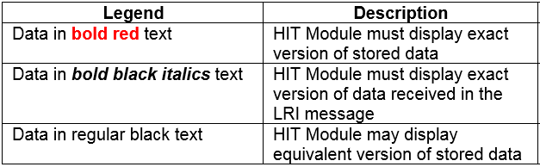
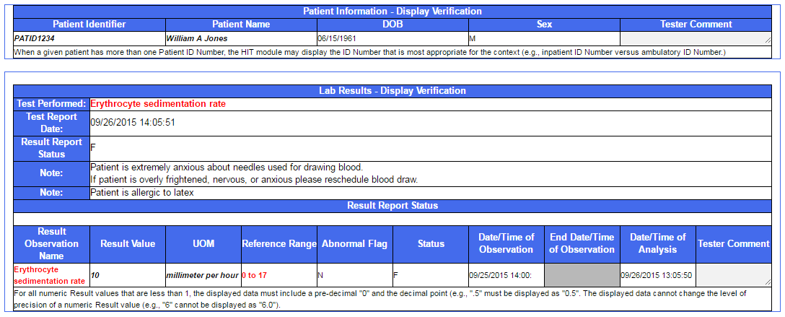
The Juror Document – Display Verification
Display Verification uses text font and color to indicate the display requirements as shown in the legend table and the document excerpt below

Slide 30
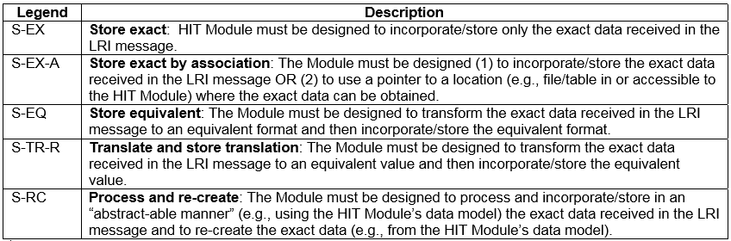
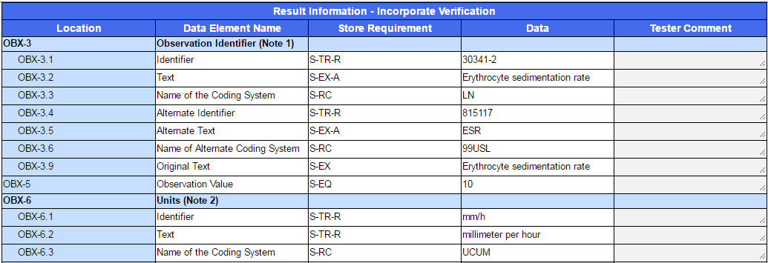
The Juror Document – Incorporate Verification
Incorporate Verification uses codes to indicate the incorporate requirements as shown in the legend table and the document excerpt below

Slide 31
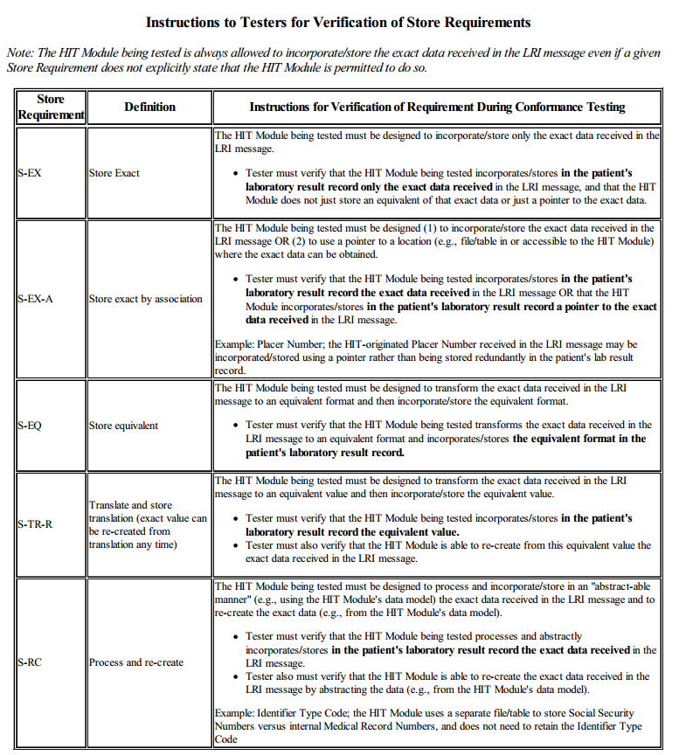
The Juror Document – Incorporate Verification (cont’d)
Detailed instructions to Testers are provided at the end of the Juror Document explaining how to verify that the HIT Module meets the Store Requirements for Incorporation of lab results

Slide 32
NIST LRI-EHR Test Tool Overview
Purpose: The tool generates LRI messages to be received/incorporated by HIT Modules and is intended to be used for conformance testing according to the standards listed on the Conformance Standards page of this slide set
Tool Key Capabilities
Context-based testing / EHR Test Plan | Used for conformance testing driven by test data Validates HIT Modules that receive and process HL7 messages in accordance with the ONC S&I Framework Lab Results Interface (LRI) implementation guide (IG) Provides Juror document for inspection testing
Profile Viewer | Provides a browse-able version of the conformance profile that encapsulates the requirements. Profile Viewer tab is accessible in Context-based testing once a Test Case or Test Step is “loaded”. Can be used to assist in the interpretation of message errors.
Value Sets Browser | Provides a browse-able view of the Value Sets and Vocabulary requirements. Value Sets tab is accessible in Context-based testing once a Test Case or Test Step is “loaded”. Can be used to assist in the interpretation of value set errors.
Documentation | Provides access to documents that assist in using the Tool for conformance testing (including the NIST Normative Test Process Documents, Implementation Guides, and Release Notes).
No registration or log-in credentials are required. Simply click on the link below to access and use the Tool
NOTE: The Test Tool (.war file) can also be downloaded and installed locally.
NOTE: Web Application is compatible with Firefox, Chrome, or Safari. Recommended browsers are Firefox and Chrome.
Register to Google Group at: https://groups.google.com/d/forum/hl7v2-lab-testing to ask questions and provide feedback.
http://hl7v2-lab-r2-testing.nist.gov/lri-r2/#/cb

Slide 33
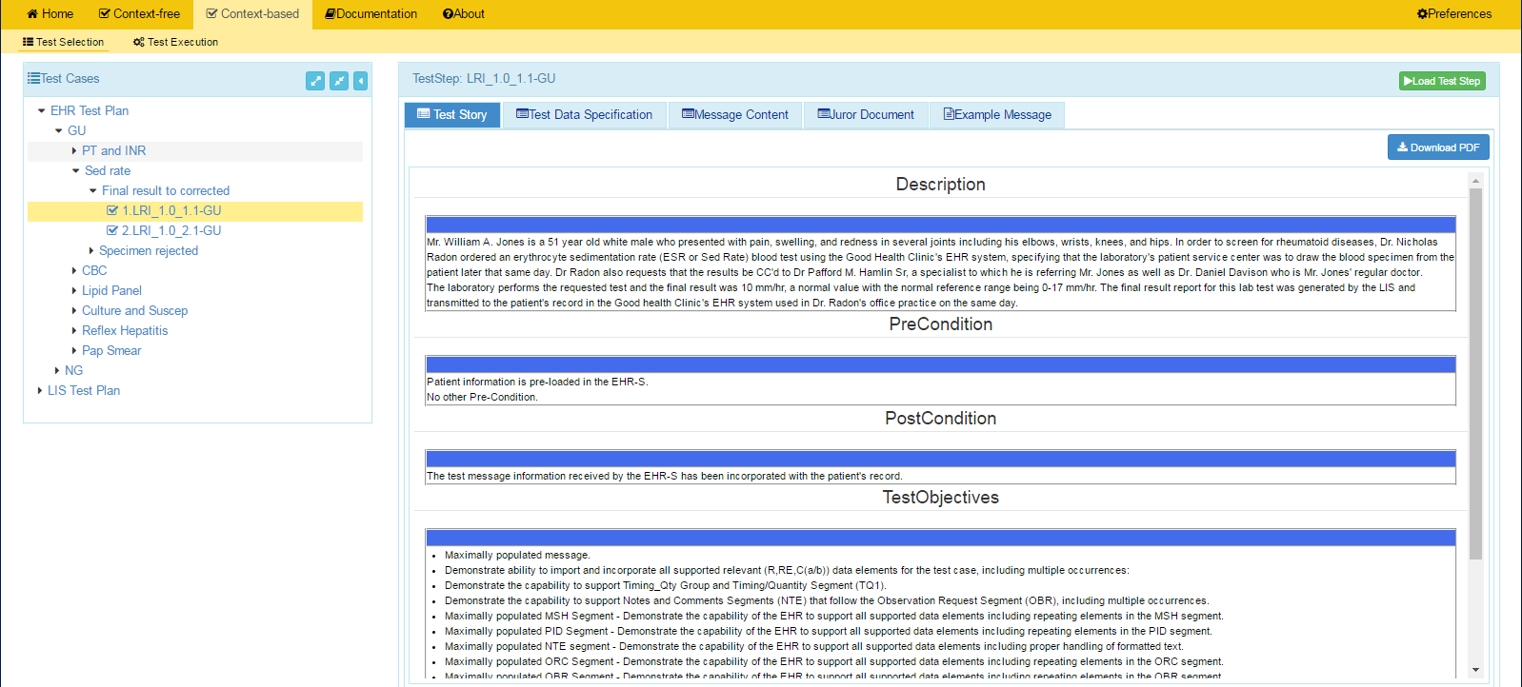
NIST LRI-EHR Test Tool Screen Shot
1
Open LRI Validation tool using link:
and click on Context-based
http://hl7v2-lab-r2-testing.nist.gov/lri-r2/#/cb
2
Test Selection view of page displays.
3
Click on arrow to open EHR Test Plan.
4
Click on arrows to expand the Test Scenarios and Test Cases. Click on a Test Step.
5
Test Step Title and Test Story tab display.
6
Click Juror Document tab to view and download the Juror Document.
HIT Context-based Validation
This feature is used to test HIT Modules for conformance to the LRI standards. The majority of the validation involves inspection testing. This process utilizes an inspector to ascertain if the lab results provided in the test message are displayed by and incorporated into the Module. The Juror Document guides the inspector through the assessment process. Another type of validation pertains to the automated testing that assesses the Acknowledgements (ACK) sent by the Module to the LIS Test Harness.
7
Click on Load Test Step button to proceed with conformance testing for the Test Step.

Slide 34
Resources
Test Tool Web Site http://hl7v2-lab-r2-testing.nist.gov/lri-r2/#/home provides
Test Tool (API, Web Application, and Desktop)
Test Cases/Steps, Test Stories, Test Data, Message Content Sheets, Example Messages, Juror Documents
User Documentation
Testing Artifacts
Message Profiles
Value Sets
Validation Reports
Contact
Rob Snelick (rsnelick@nist.gov)

